Slide 1
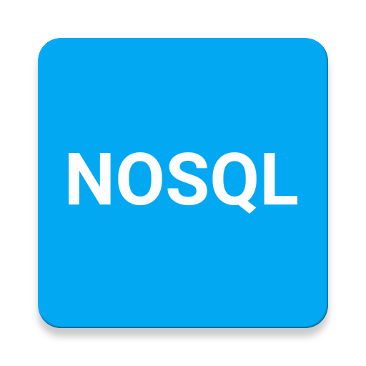
UNIT - III
Heera Rajput Bhattu, Assoc. Professor, Department of CSE, SNIST

Slide 2
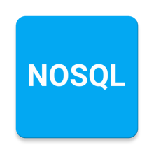
Introduction to NO SQL
A NoSQL originally referring to non SQL or non relational is a database that provides a mechanism for storage and retrieval of data. This data is modeled in means other than the tabular relations used in relational databases. Such databases came into existence in the late 1960s, but did not obtain the NoSQL moniker until a surge of popularity in the early twenty-first century. NoSQL databases are used in real-time web applications and big data and their use are increasing over time. NoSQL systems are also sometimes called Not only SQL to emphasize the fact that they may support SQL-like query languages.
Heera Rajput Bhattu, Assoc. Professor, Department of CSE, SNIST

Slide 3
Introduction to NO SQL
Types of NoSQL databases
NoSQL databases fall into four main categories:
Key value Stores — Riak, Voldemort, and Redis
Wide Column Stores — Cassandra and HBase.
Document databases — MongoDB
Graph databases — Neo4J and HyperGraphDB.
Heera Rajput Bhattu, Assoc. Professor, Department of CSE, SNIST

Slide 4
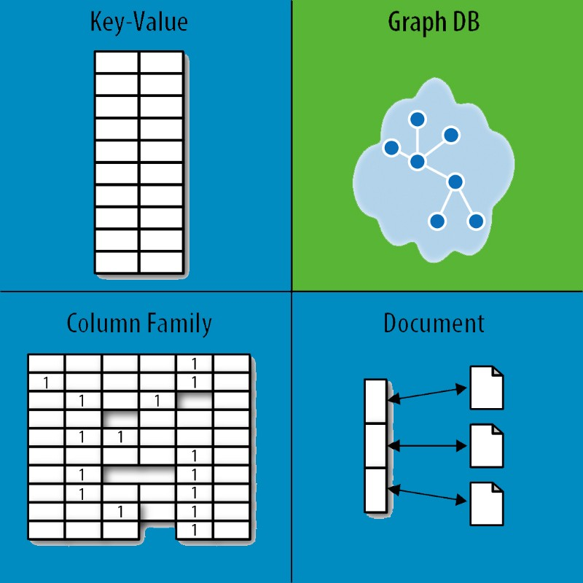
Introduction to NO SQL
Heera Rajput Bhattu, Assoc. Professor, Department of CSE, SNIST

Slide 5
Introduction to NO SQL
JavaScript Object Notation (JSON) is an open standard file format, and data interchange format, that uses human-readable text to store and transmit data objects consisting of attribute–value pairs and array data types (or any other serializable value).
Heera Rajput Bhattu, Assoc. Professor, Department of CSE, SNIST

Slide 6
Aggregate Data Models
A data model is the model through which we perceive and manipulate our data. For people using a database, the data model describes how we interact with the data in the database. This is distinct from a storage model, which describes how the database stores and manipulates the data internally. In an ideal world, we should be ignorant of the storage model, but in practice we need at least some inkling of it—primarily to achieve decent performance.
An aggregate is a collection of data that we interact with as a unit. These units of data or aggregates form the boundaries for ACID operations with the database, Key-value, Document, and Column-family databases can all be seen as forms of aggregate-oriented database.
Heera Rajput Bhattu, Assoc. Professor, Department of CSE, SNIST

Slide 7
Aggregate Data Models
One of the most obvious shifts with NoSQL is a move away from the relational model. Each NoSQL solution has a different model that it uses, which we put into four categories widely used in the NoSQL ecosystem: key-value, document, column-family, and graph. Of these, the first three share a common characteristic of their data models which we will call aggregate orientation.
Heera Rajput Bhattu, Assoc. Professor, Department of CSE, SNIST

Slide 8
Aggregate Data Models
The relational model takes the information that we want to store and divides it into tuples (rows). A tuple is a limited data structure: It captures a set of values, so you cannot nest one tuple within another to get nested records, nor can you put a list of values or tuples within another. This simplicity underpins the relational model—it allows us to think of all operations as operating on and returning tuples.Aggregate orientation takes a different approach. It recognizes that often, you want to operate on data in units that have a more complex structure than a set of tuples. It can be handy to think in terms of a complex record that allows lists and other record structures to be nested inside it. As we’ll see, key-value, document, and column-family databases all make use of this more complex record. However, there is no common term for this complex record; in this book we use the term “aggregate.”
Heera Rajput Bhattu, Assoc. Professor, Department of CSE, SNIST

Slide 9
Aggregates
Aggregate is a term that comes from Domain-Driven Design. In Domain-Driven Design, an aggregate is a collection of related objects that we wish to treat as a unit. In particular, it is a unit for data manipulation and management of consistency. Typically, we like to update aggregates with atomic operations and communicate with our data storage in terms of aggregates. This definition matches really well with how key-value, document, and column-family databases work. Dealing in aggregates makes it much easier for these databases to handle operating on a cluster, since the aggregate makes a natural unit for replication and sharding. Aggregates are also often easier for application programmers to work with, since they often manipulate data through aggregate structures.
Heera Rajput Bhattu, Assoc. Professor, Department of CSE, SNIST

Slide 10
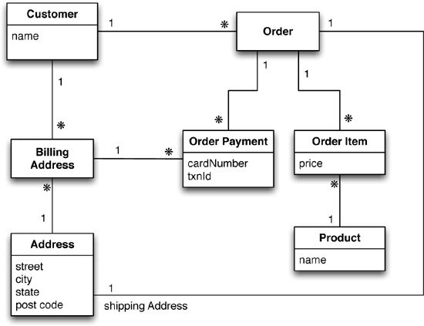
Aggregates
Relational Data Model
Heera Rajput Bhattu, Assoc. Professor, Department of CSE, SNIST

Slide 11
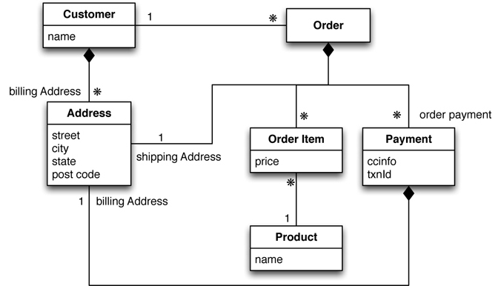
Aggregates
Aggregate Data Model
Heera Rajput Bhattu, Assoc. Professor, Department of CSE, SNIST

Slide 12
Key-Value and Document Data Models
We said earlier on that key-value and document databases were strongly aggregate-oriented. What we meant by this was that we think of these databases as primarily constructed through aggregates. Both of these types of databases consist of lots of aggregates with each aggregate having a key or ID that’s used to get at the data.
Heera Rajput Bhattu, Assoc. Professor, Department of CSE, SNIST

Slide 13
Key-Value and Document Data Models
The two models differ in that in a key-value database, the aggregate is opaque to the database—just some big blob of mostly meaningless bits. In contrast, a document database is able to see a structure in the aggregate. The advantage of opacity is that we can store whatever we like in the aggregate. The database may impose some general size limit, but other than that we have complete freedom. A document database imposes limits on what we can place in it, defining allowable structures and types. In return, however, we get more flexibility in access.
Heera Rajput Bhattu, Assoc. Professor, Department of CSE, SNIST

Slide 14
Relationships
Compared to a traditional relational database (SQL), a document oriented (NoSQL) database has poor or non-existent support for relations between objects (data schema).
"NoSQL" as meaning "not relational" i.e. there is no primary key / foreign key concept; there is no "normalization" enforced or implied; there is no real meaning of the words "table" or "column". To a key-value store all it knows about is a big collection of bytes you pass to it - the "value" - and a smaller collection of bytes - the "key" - used to index that big collection. What is inside that big collection and how it maps onto byte in other values in the database depends on the application and the quality of the code in it.
Heera Rajput Bhattu, Assoc. Professor, Department of CSE, SNIST

Slide 15
Relationships
Some NoSQL DBMSs, however, do allow to define what is inside the "value". They hold a schema for the data, much like relational databases do. E.g. Cassandra
The user can set up a key-value store to mimic a relational data model with surrogate ids. This requires a lot of reads and lose the point of a NoSQL solution. Alternatively, the user can set up key-values to store all de-normalized values at the instant the record was written. This will be fast for retrieval but slow for updates.
Heera Rajput Bhattu, Assoc. Professor, Department of CSE, SNIST

Slide 16
Graph Databases
The NoSQL (‘not only SQL’) graph database is a technology for data management designed to handle very large sets of structured, semi-structured or unstructured data. It helps organizations access, integrate and analyze data from various sources, thus helping them with their big data and social media analytics.
Graph databases are NoSQL databases which use the graph data model comprised of vertices, which is an entity such as a person, place, object or relevant piece of data and edges, which represent the relationship between two nodes.
Graph databases are particularly helpful because they highlight the links and relationships between relevant data similarly to how we do so ourselves.
Heera Rajput Bhattu, Assoc. Professor, Department of CSE, SNIST

Slide 17
Graph Databases
Clearly, this architecture pattern deals with storage and management of data in graphs. Graphs are basically structures that depict connections between two or more objects in some data.The objects or entities are called as nodes and are joined together by relationships called Edges. Each edge has a unique identifier. Each node serves as a point of contact for the graph.This pattern is very commonly used in social networks where there are a large number of entities and each entity has one or many characteristics which are connected by edges. The relational database pattern has tables which are loosely connected, whereas graphs are often very strong and rigid in nature.
Advantages:
Fastest traversal because of connections.
Spatial data can be easily handled.
Limitations: Wrong connections may lead to infinite loops.
Examples:
Neo4J
FlockDB( Used by Twitter)
Heera Rajput Bhattu, Assoc. Professor, Department of CSE, SNIST

Slide 18
Schemaless Databases
All NoSQL databases claim to be schema-less, which means there is no schema enforced by the database themselves. Databases with strong schemas, such as relational databases, can be migrated by saving each schema change, plus its data migration, in a version-controlled sequence.
Schema-less databases still need careful migration due to the implicit schema in any code that accesses the data.
Schema-less databases can use the same migration techniques as databases with strong schemas.
In schema-less databases we can also read data in a way that's tolerant to changes in the data's implicit schema and use incremental migration to update data, thus allowing for zero downtime deployments, making them more popular with 24*7 systems.
Heera Rajput Bhattu, Assoc. Professor, Department of CSE, SNIST

Slide 19
Schemaless Databases
A collection of documents
Data in this model is stored inside documents.
A document is a key value collection where the key allows access to its value.
Documents are not typically forced to have a schema and therefore are flexible and easy to change.
Documents are stored into collections in order to group different kinds of data.
Documents can contain many different key-value pairs, or key-array pairs, or even nested documents.
The differences between Relational and Document model are:
Relational model | Document model
Tables | Collections
Rows | Documents
Columns | Key/value pairs
Joins | not available
Heera Rajput Bhattu, Assoc. Professor, Department of CSE, SNIST

Slide 20
Materialized Views
A View is a virtual relation that acts as an actual relation. It is not a part of logical relational model of the database system. Tuples of the view are not stored in the database system and tuples of the view are generated every time the view is accessed. Query expression of the view is stored in the databases system.
Views can be used everywhere were we can use the actual relation. Views can be used to create custom virtual relations according to the needs of a specific user. We can create as many views as we want in a databases system.
When the results of a view expression are stored in a database system, they are called materialized views. SQL does not provides any standard way of defining materialized view, however some database management system provides custom extensions to use materialized views. The process of keeping the materialized views updated is know as view maintenance.
Heera Rajput Bhattu, Assoc. Professor, Department of CSE, SNIST

Slide 21
Distribution Models
Aggregate oriented databases make distribution of data easier, since the distribution mechanism has to move the aggregate and not have to worry about related data, as all the related data is contained in the aggregate. There are two styles of distributing data:
Sharding:
Sharding distributes different data across multiple servers, so each server acts as the single source for a subset of data.
Replication:
Replication copies data across multiple servers, so each bit of data can be found in multiple places.
Heera Rajput Bhattu, Assoc. Professor, Department of CSE, SNIST

Slide 22
Distribution Models
Replication comes in two forms:
Master-slave replication makes one node the authoritative copy that handles writes while slaves synchronize with the master and may handle reads.
Peer-to-peer replication allows writes to any node; the nodes coordinate to synchronize their copies of the data.
Master-slave replication reduces the chance of update conflicts but peer-to-peer replication avoids loading all writes onto a single server creating a single point of failure. A system may use either or both techniques.
Like Riak database shards the data and also replicates it based on the replication factor.
Heera Rajput Bhattu, Assoc. Professor, Department of CSE, SNIST

Slide 23
Sharding
Sharding is a type of database partitioning that separates very large databases into smaller, faster, more easily managed parts called data shards. The word shard means a small part of a whole.
Heera Rajput Bhattu, Assoc. Professor, Department of CSE, SNIST

Slide 24
Sharding
Heera Rajput Bhattu, Assoc. Professor, Department of CSE, SNIST

Slide 25
Sharding
Heera Rajput Bhattu, Assoc. Professor, Department of CSE, SNIST

Slide 26
Master-Slave Replication
Data replication is the concept of having data, within a system, be geo-distributed; preferably through a non-interactive, reliable process. Instead, these systems can be backed up via a semi-manual process where live recovery wouldn't be much of an issue.
Heera Rajput Bhattu, Assoc. Professor, Department of CSE, SNIST

Slide 27
Master-Slave Replication
Heera Rajput Bhattu, Assoc. Professor, Department of CSE, SNIST

Slide 28
Master-Slave Replication
Heera Rajput Bhattu, Assoc. Professor, Department of CSE, SNIST

Slide 29
Master-Slave Replication
Heera Rajput Bhattu, Assoc. Professor, Department of CSE, SNIST

Slide 30
Peer-Peer Replication
Master-Slave replication helps with read scalability but doesn’t help with scalability of writes. It provides resilience against failure of a slave but not against master. Peer-to-peer replication attacks these problems by not having a master. All the replicas have equal weight. They can all accept WRITES and the loss of any of them does not prevent access to the data store.
With a peer-to-peer replication cluster, we can ride over node failures without losing access to data. Furthermore, we can easily add nodes to improve the performance.
Heera Rajput Bhattu, Assoc. Professor, Department of CSE, SNIST

Slide 31
Peer-Peer Replication
Heera Rajput Bhattu, Assoc. Professor, Department of CSE, SNIST

Slide 32
Peer-Peer Replication
Heera Rajput Bhattu, Assoc. Professor, Department of CSE, SNIST

Slide 33
Sharding and Replication
REPLICATION creates additional copies of the data and allows for automatic failover to another node. Replication may help with horizontal scaling of READS if you are OK to read data that potentially isn't the latest.
SHARDING allows for horizontal scaling of data writes by partitioning data across multiple servers using a shard key. It's important to choose a good shard key.
For example, a poor choice of shard key could lead to "hot spots" of data only being written on a single shard.
Heera Rajput Bhattu, Assoc. Professor, Department of CSE, SNIST

Slide 34
Sharding and Replication
Heera Rajput Bhattu, Assoc. Professor, Department of CSE, SNIST

Slide 35
Sharding and Replication
Heera Rajput Bhattu, Assoc. Professor, Department of CSE, SNIST

Slide 36
Thank You
Heera Rajput Bhattu, Assoc. Professor, Department of CSE, SNIST

